Slide 1

Extraction of rare earth elements
Group: 11
Submitted by:
Harshit Katariya (210107033)
Jagdish Panda (210107034)
Mihir Anand (210107051)

Slide 2
Table of contents
Introduction
Primary methods of extraction of Rare Earth Metals
Methods of extracting rare earth metals from compounds
References
Summary

Slide 3

Introduction
1. The commitment to clean energy technologies and the projected growth in power and transportation sectors globally are driving an increasing demand for rare earth metals like yttrium and scandium, essential for various applications such as clean energy technologies, phosphors, lasers, and magnets.
2. Sustainability is a critical concern in the utilization and disposal of inorganic materials, emphasizing the need for technologies that support materials recovery and recycling to conserve energy and natural resources.
3. Despite efforts to recycle metals, a significant portion of post-consumer metal scrap remains unrecovered, leading to a reliance on primary metals production, which escalates global energy consumption and greenhouse gas emissions.
4. Rare earth elements, a group of 17 elements including 15 Lanthanides, Scandium, and Yttrium, are not actually rare but have gained strategic importance for economies worldwide due to the shortage of minable resources and increasing demand.
5. Historically, rare earth metals were primarily sourced from placer deposits in Brazil and India, but with rising demand, newer supply sources like monazite deposits in South Africa and Bastnasite reserves in Mountain Pass and China have become dominant.

Slide 4

Introduction
6. The world's rare earth demand is projected to reach 200,000 tons by 2014, with Chinese production expected to be around 160,000 tons, reflecting a 380% increase in China's own demand between 2000 and 2009.
7. The Rare Earths and Critical Material Revitalization Act of 2010 underscores the strategic importance of rare earth elements, particularly heavy rare earths like Dysprosium, Neodymium, and Yttrium, prompting the establishment of an R&D program to ensure a long-term supply of these materials.
8. The criticality analysis of selected rare metals by the US Department of Energy identified Dysprosium, Neodymium, Terbium, Yttrium, and Europium as the most critical elements, known as heavy rare earth elements.
9. The prices of common rare earth metals like Ce, Nd, Sm, La, and Y experienced significant increases of 150% to 700% within a short period, highlighting the demand-supply dynamics and strategic importance of these elements.
10. Various methods such as selective oxidation, reduction, fractional crystallization, ion exchange, and solvent extraction are employed to produce rare earth oxides and metals, each offering distinct advantages for separating and recovering these valuable elements.

Slide 5
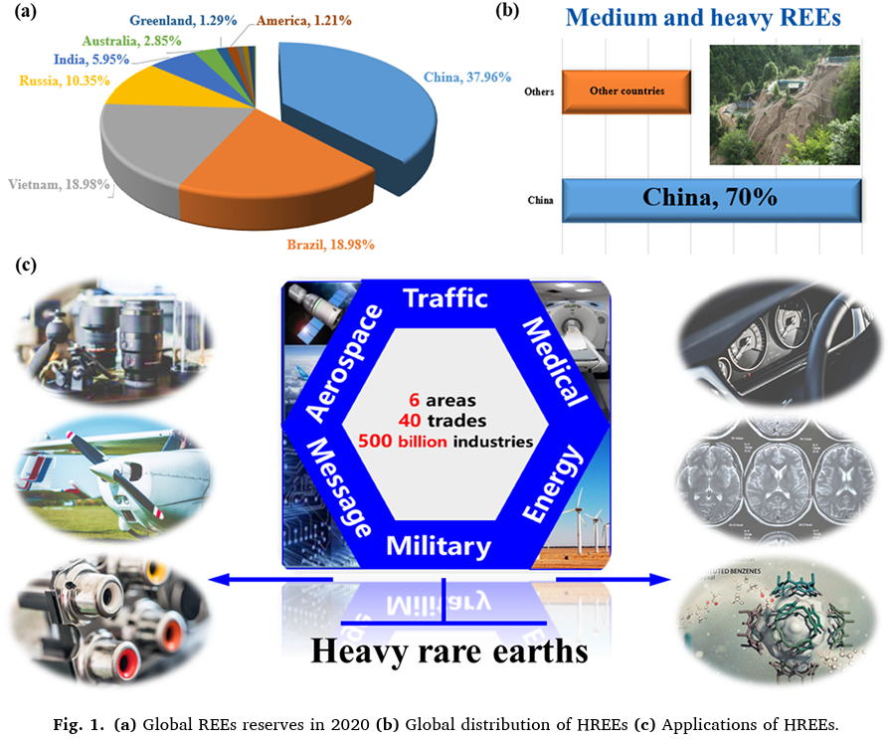

Slide 6
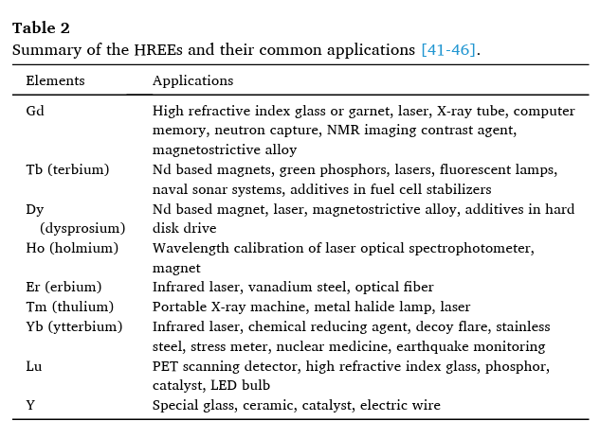

Slide 7

Methods of Extraction of Rare Earth Metals
Rare earth metals can be extracted by five commonly used methods:
1. Selective oxidation
2.Selective reduction
3.Fractional crystallization
4.Ion exchange
5.Solvent extraction.
Additionally, there are various other methods practiced for producing pure rare earth metals from compounds:
1. Reduction of anhydrous chlorides and fluorides
2. Direct reduction of rare earth oxides
3. Fused salt electrolysis of rare earth chlorides or oxide fluoride mixtures

Slide 8
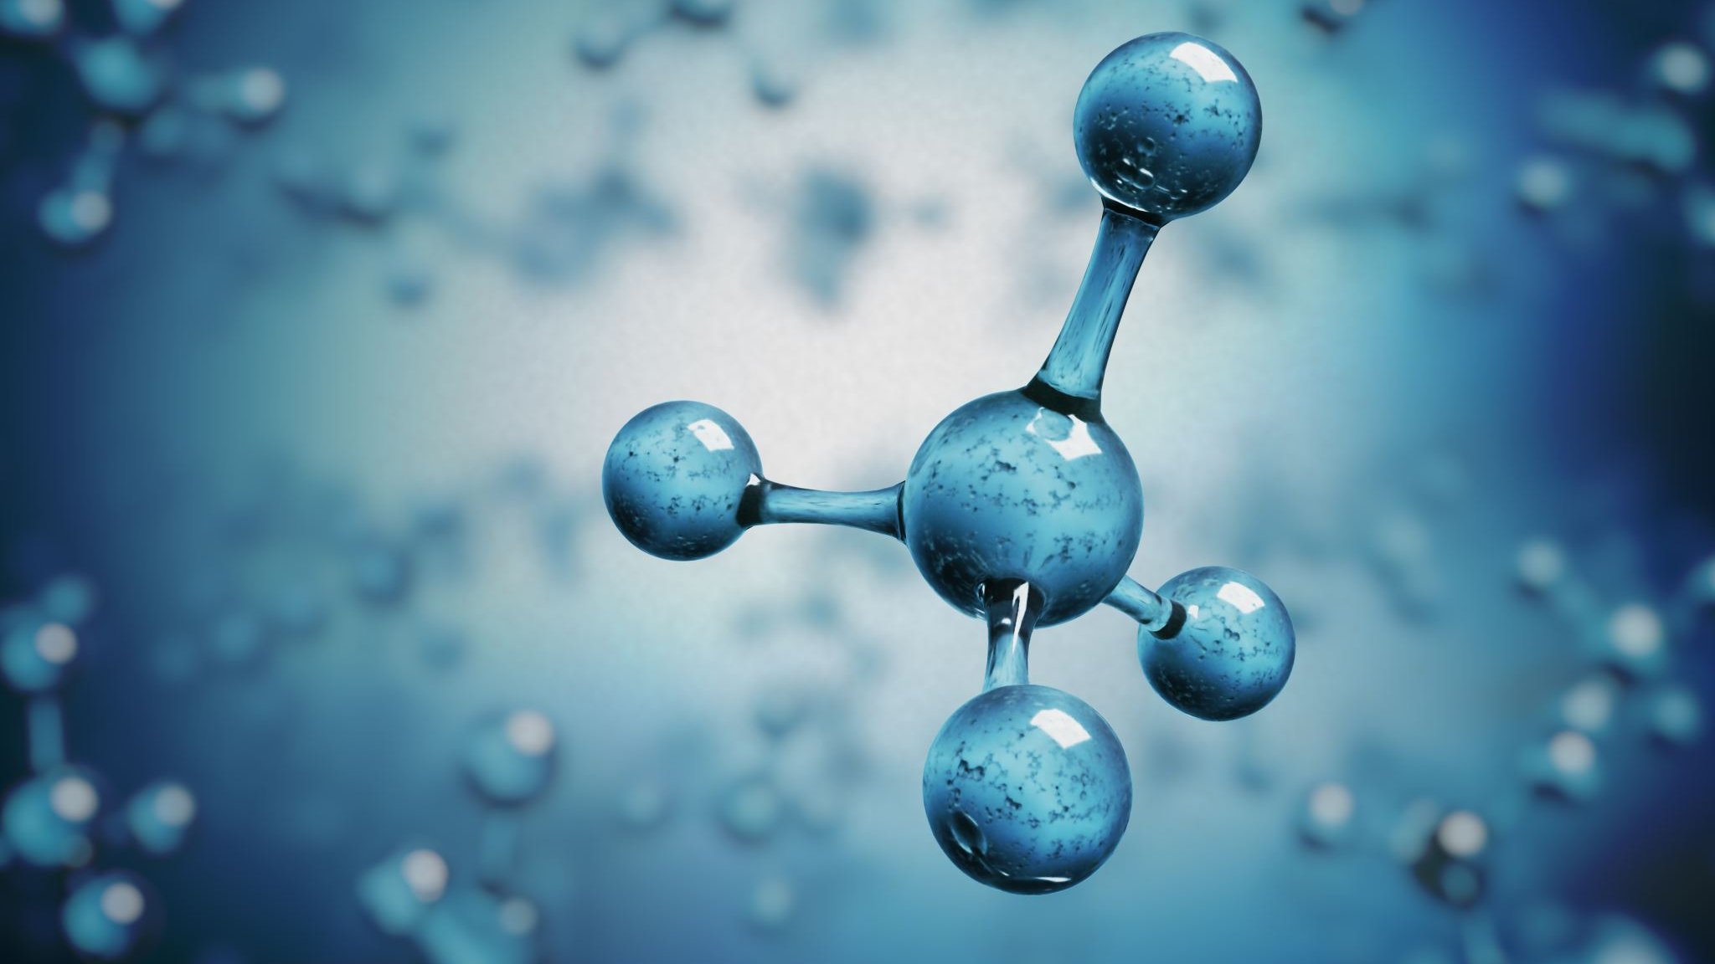
Selective Oxidation
1. Selective oxidation is a method used to separate rare earth metals like cerium, praseodymium, and terbium by converting them from a trivalent state to a tetravalent state, allowing for their separation.
2. Persulfates, permanganate, and hypochlorite are commonly used as oxidizing agents in selective oxidation reactions, with air or oxygen also serving as oxidizing agents for these processes.
3. In the selective oxidation of praseodymium and terbium, the tetravalent states of these metals precipitate out as rare earth oxides and settle due to their instability in aqueous solutions, facilitating their separation.
4. For cerium, selective oxidation involves separating the tetravalent cerium from the rare earth mixture by selectively dissolving trivalent elements in a dilute acid or completely dissolving all species in a concentrated acid followed by precipitation.
5. The tetravalent cerium can be precipitated from the acidic solution through pH control, enabling the separation and recovery of cerium through selective oxidation processes.
6. Selective oxidation plays a crucial role in the production of rare earth oxides by enabling the separation of specific rare earth metals based on their oxidation states, contributing to the efficient recovery of these valuable elements.

Slide 9
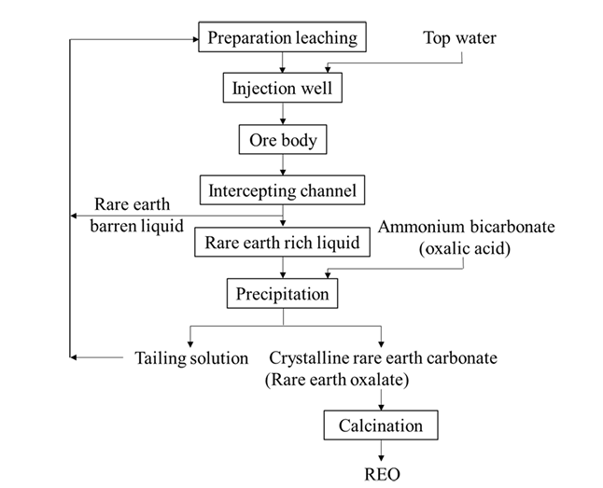

Slide 10
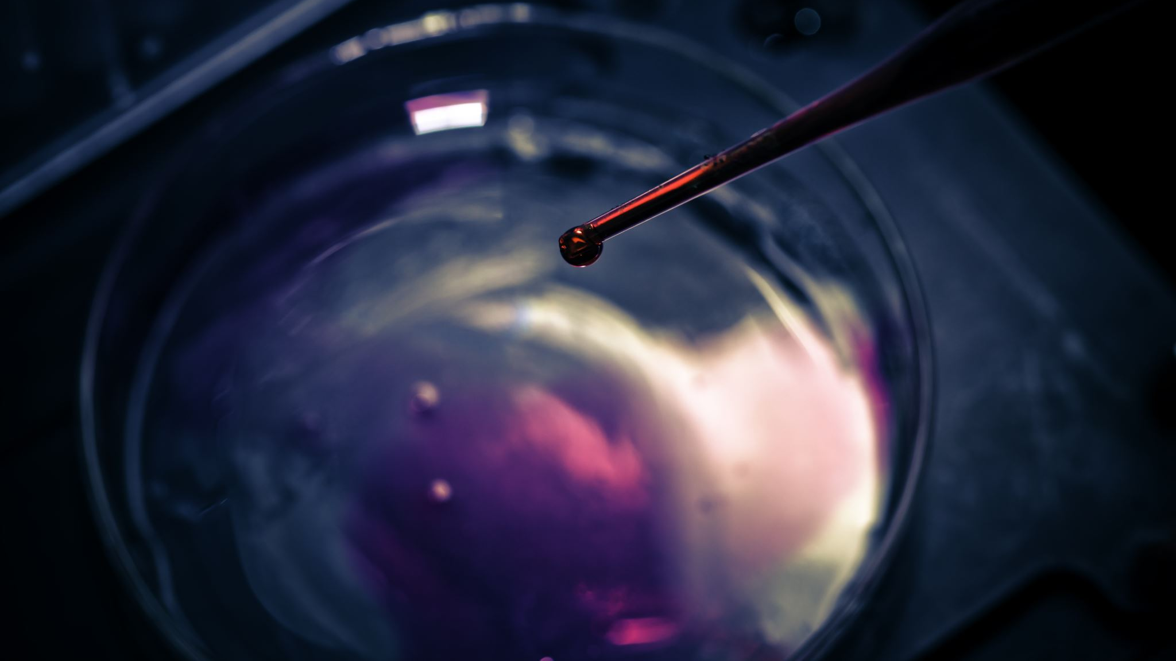
Selective Reduction
1. Selective reduction is a method used to separate rare earth metals like samarium, europium, and ytterbium by reducing them to a divalent state, allowing for their separation from other elements.
2. In selective reduction, samarium and europium can be separated by reductive extraction into dilute sodium amalgam, while ytterbium can be separated using a method developed by Marsh for selective reduction.
3. McCoy developed a commercially used method for the selective reduction of europium, where Eu (III) is reduced to Eu (II) by zinc in a chlorine solution, leading to the precipitation of divalent europium as a sulfate for further processing.
4. Unlike samarium and europium, zinc does not effectively reduce ytterbium, necessitating the use of a different method developed by Marsh for the selective reduction of ytterbium and samarium.
5. Selective reduction offers an effective way to separate specific rare earth metals based on their reduction states, contributing to the efficient recovery and purification of these valuable elements.
6. The method of selective reduction plays a crucial role in the production of rare earth metals by enabling the separation of specific elements through their reduction to a divalent state, facilitating their extraction and purification.

Slide 11
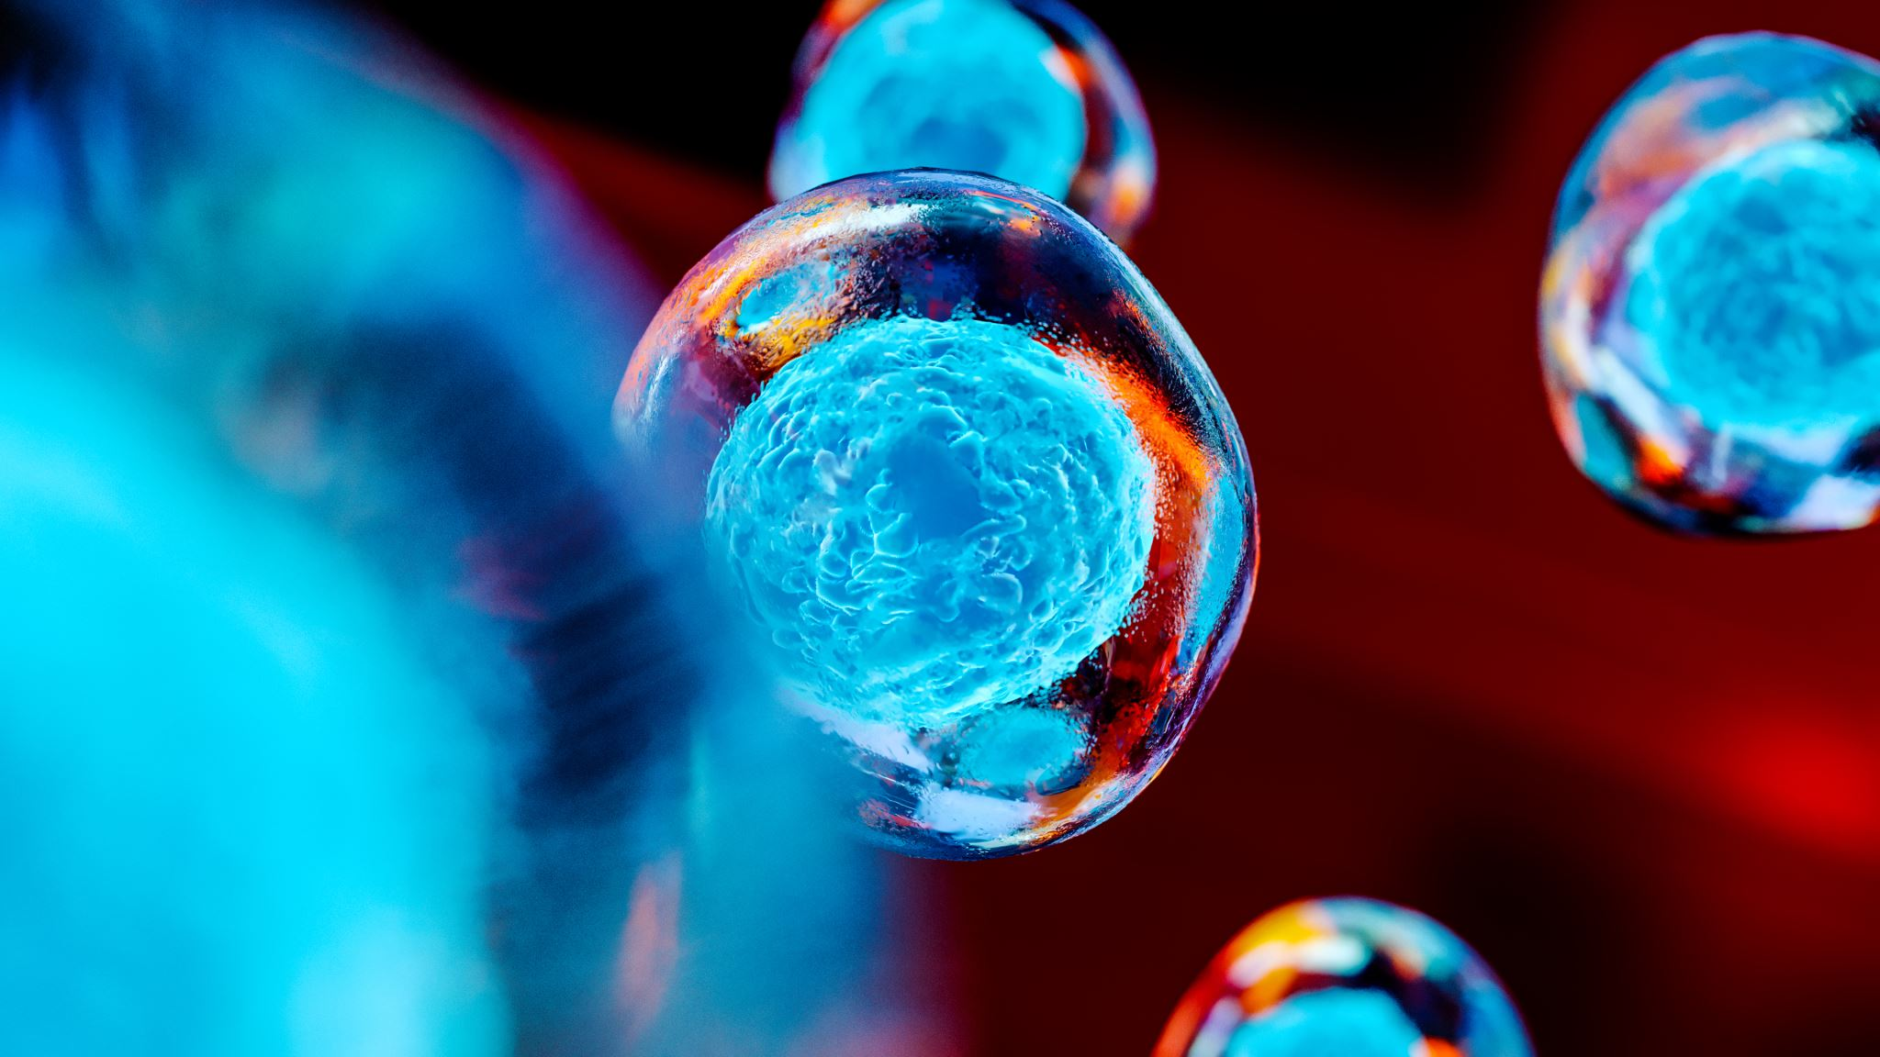
Fractional Crystallization
1. Fractional crystallization is a method used to separate rare earth elements based on their different solubilities in a solution, allowing for the crystallization and separation of specific components.
2. In this process, rare earth solutions are mixed with a salt and then heated, followed by gradual cooling to induce the crystallization of rare earth oxides out of the solution, enabling their separation.
3. Ammonium nitrate salts are commonly employed for the separation of praseodymium and neodymium, while double magnesium nitrates are used for separating samarium, europium, gadolinium, and the ceric group in the fractional crystallization process.
4. Bromates and ethyl sulfates are utilized in the separation of the yttric group during fractional crystallization, showcasing the versatility of this method in selectively separating different rare earth elements based on their properties.
5. Fractional crystallization is particularly suitable for lanthanides at the lower end of the series, offering an effective means of isolating specific rare earth metals from complex mixtures through controlled crystallization processes.
6. This method plays a significant role in the production of rare earth oxides by enabling the selective separation of specific rare earth elements based on their solubilities, contributing to the efficient recovery and purification of these valuable elements.

Slide 12
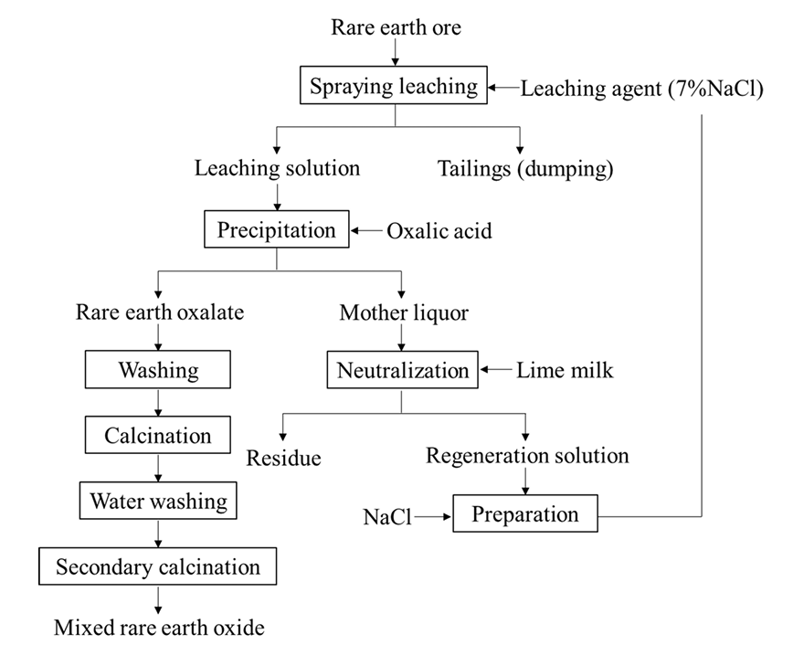

Slide 13
Ion Exchange
1. Ion exchange is a separation method involving the interchange of ions between an aqueous solution and an insoluble resin, consisting of absorption and elution steps for metal recovery from the resin bed.
2. This process is suitable for rare earth separation on a small scale due to its batch nature, with a commercially used method involving the recovery of rare earth compounds using amberlite type resins and elution with completing agents like citric acid, EDTA, and HEDTA.
3. Neutral organic extractants like TBP are commonly used in ion exchange for the recovery of mixed rare earth oxides, while basic extractants are employed to recover anionic lanthanides, and acidic extractants like DEPHA are powerful for separating most rare earth metals.
4. Ion exchange reactions offer versatility in separating rare earth elements based on their properties, providing an effective means of selectively recovering specific rare earth metals from solutions through resin-based interactions.
5. The method's ability to interchange ions between solution and resin allows for the successful separation of various rare earth elements, contributing to the efficient recovery and purification of these valuable metals.
6. Ion exchange plays a crucial role in the production of rare earth metals by enabling the selective recovery of specific elements through resin-based interactions, enhancing the overall efficiency of rare earth element extraction and purification processes.

Slide 14

Solvent Extraction
1. Solvent extraction is an economical method used for separating rare earth metals by transferring them from an aqueous solution to an immiscible organic solvent, followed by a phase separation based on different densities.
2. In this process, rare earth metals are transferred to the organic phase, allowing for their recovery through phase separation, with the choice of organic extractant crucial for the efficiency of the separation process.
3. Neutral organic extractants like tributyl phosphate (TBP) are commonly used in solvent extraction for the recovery of mixed rare earth oxides, while acidic extractants like DEPHA are powerful for separating most rare earth metals, and basic extractants are employed for recovering anionic lanthanides.
4. Solvent extraction offers versatility in separating rare earth elements based on their properties, providing an effective means of selectively recovering specific rare earth metals from solutions through organic solvent interactions.
5. The method's ability to transfer rare earth metals to an organic phase enables the successful separation of various rare earth elements, contributing to the efficient recovery and purification of these valuable metals.
6. Solvent extraction plays a significant role in the production of rare earth metals by enabling the selective recovery of specific elements through organic solvent interactions, enhancing the overall efficiency of rare earth element extraction and purification processes.

Slide 15
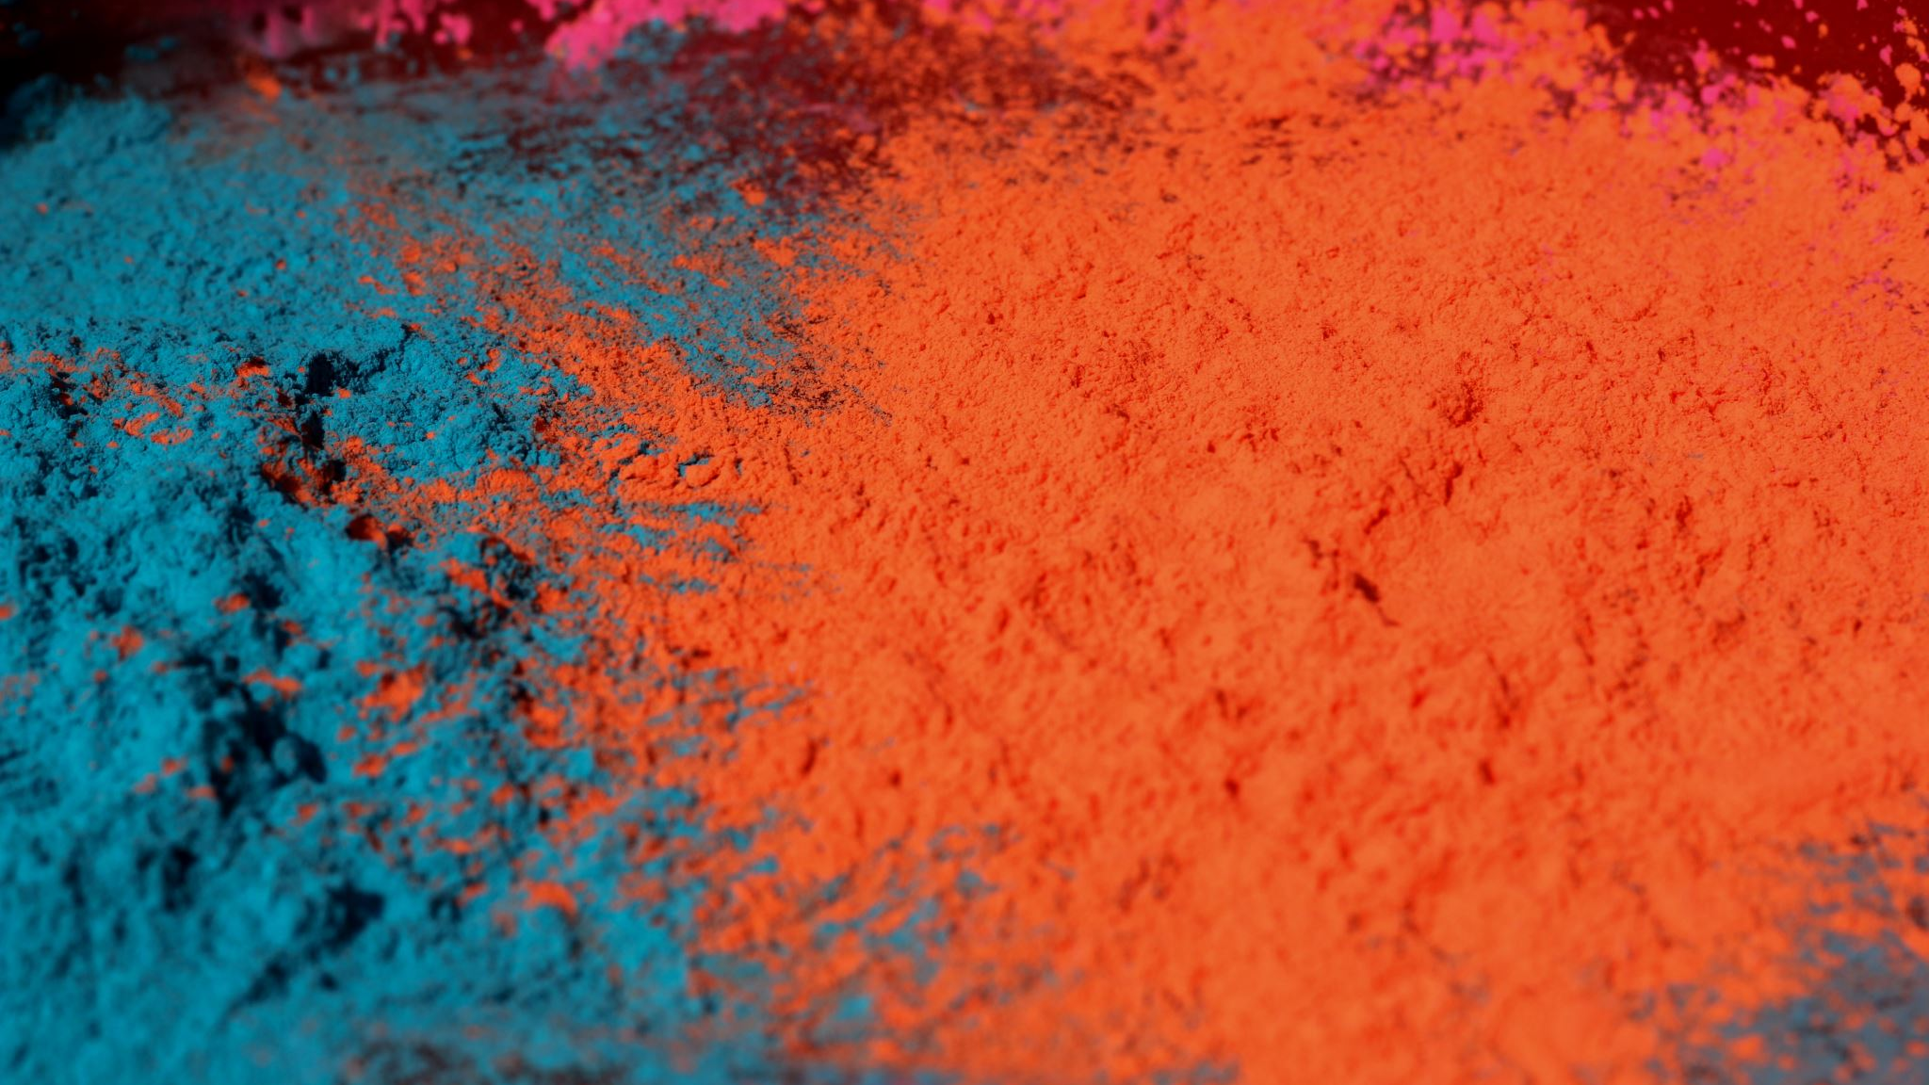
Direct Reduction of Rare Earth Oxides
1. The direct reduction of rare earth oxides is a method that involves reducing rare earth oxides to metals without the need for pre-transformation into halides, offering a direct pathway to obtain pure rare earth metals.
2. Early attempts at direct reduction by Winckler, Matignon, and Hirsch using magnesium or calcium as reducing agents were ineffective as the resulting mixture contained oxides and metals that could not be easily separated.
3. A breakthrough in direct reduction was achieved by Daane in 1953 for reducing volatile rare earth metals, where rare earth oxides were mixed with lanthanum chips in a tantalum crucible under high temperature and vacuum conditions, leading to the sublimation and collection of rare earth metals as crystalline condensates.
4. On statt also explored direct reduction using calcium instead of lanthanum, but this method required multiple distillations to remove impurities and only yielded around 40% pure rare earth metals.
5. General Motors developed a molten salt process in 1988 for direct reduction, involving placing a rare earth oxide with calcium chloride and sodium chloride in a reaction vessel, where calcium metal reduces the rare earth oxide to a rare earth metal at temperatures above the melting point of the constituents but below the vaporization temperature of sodium metal.
6. Direct reduction of rare earth oxides offers a promising route to obtain pure rare earth metals, with various methods and techniques developed over the years to improve efficiency and purity in the production process.

Slide 16
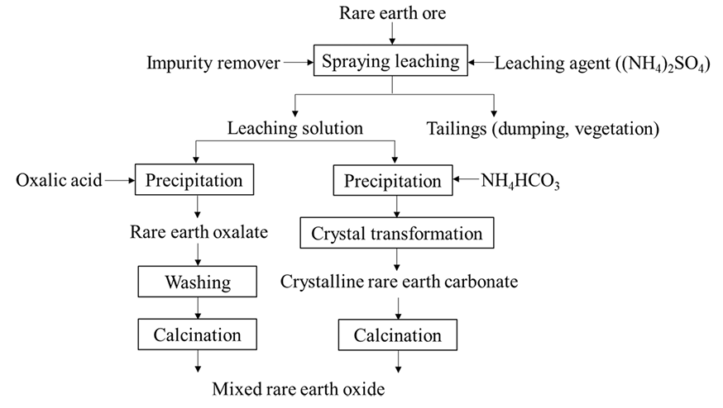

Slide 17
Reduction of anhydrous chlorides and fluorides
1. The reduction of anhydrous rare earth chlorides and fluorides is a method used to produce pure rare earth metals by transforming these compounds into metals through specific reduction processes.
2. This method involves the pre-transformation of rare earth oxides into chlorides or fluorides before the reduction process, allowing for a variety of reducing agents to be used due to the less stability of the halides compared to oxides.
3. Metallothermic reduction of rare earth chlorides has been studied extensively, with processes involving magnesium, calcium, lithium, and sodium as reducing agents to produce metals like cerium, neodymium, gadolinium, and yttrium.
4. Techniques such as reduction with magnesium or calcium in dolomite-lined steel bombs, reduction with calcium in tantalum crucibles, and reduction with lithium vapor have been developed to efficiently produce rare earth metals from their chlorides.
5. Metallothermic reduction of rare earth fluorides, although less common than chlorides, has also been explored, with successful methods developed using calcium as the reducing agent in high-temperature reactions under argon atmospheres.
6. Reduction through molten salt electrolysis is another viable option for producing rare earth metals, offering a less complex and expensive alternative to metallothermic reduction methods, with successful production of lanthanum, cerium, praseodymium, and didymium achieved through fused salt electrolysis of chlorides on a commercial scale.

Slide 18
Fused salt electrolysis of rare earth chlorides or oxide-flourides mixtures
1. Fused salt electrolysis is a viable method for producing rare earth metals, offering a less complex and expensive alternative to metallothermic reduction methods, with a focus on the theoretical decomposition potential to determine feasibility.
2. This process involves the electrolysis of rare earth chloride mixtures at temperatures up to 1100°C, as higher temperatures can lead to the volatility of electrolyte constituents and severe attack on cell wall materials by rare earth metals.
3. Lanthanum, cerium, praseodymium, and didymium (an alloy of neodymium) have been successfully produced through fused salt electrolysis of chlorides on a commercial scale, highlighting the method's effectiveness in rare earth metal production.
4. The electrolysis cell operates at a maximum temperature of 1100°C to prevent issues related to the volatility of electrolyte constituents and the potential damage to cell wall materials by rare earth metals during the process.
5. Fused salt electrolysis offers a controlled and efficient way to recover rare earth metals from chlorides or oxide fluoride mixtures, ensuring the production of high-quality rare earth metals for various industrial applications.
6. By utilizing fused salt electrolysis, rare earth metals like lanthanum, cerium, praseodymium, and didymium can be extracted and purified, contributing to the supply of these critical materials for technological advancements and industrial processes.

Slide 19

Summary
1. Rare earth metals like yttrium and scandium are vital for clean energy technologies, lasers, and magnets, with increasing demand due to global clean energy initiatives and technological advancements.
2. Ensuring secure supply chains for rare earth elements is crucial to support technological innovation and address supply-demand imbalances, necessitating intelligent processing, recycling, and reuse of rare earth elements from secondary sources like post-consumer and manufacturing wastes.
3. The strategic importance of rare earth elements has grown due to limited minable resources, leading to shifts in production sources from placer deposits to reserves like monazite in South Africa and Bastnasite in Mountain Pass and China.
4. Global rare earth demand is projected to rise significantly, with China playing a dominant role in production, prompting strategic concerns and initiatives like the Rare Earths and Critical Material Revitalization Act of 2010 in the United States to secure a stable supply of these critical materials.
5. Various methods for producing rare earth metals are explored, including the reduction of anhydrous chlorides and fluorides, direct reduction of rare earth oxides, and fused salt electrolysis of rare earth chlorides or oxide fluoride mixtures, each offering distinct advantages and challenges in the production process.
6. Efficient methods for preparing rare earth oxides, such as selective oxidation, selective reduction, fractional crystallization, ion exchange, and solvent extraction, are crucial for producing pure rare earth metals from compounds, contributing to technological advancements and industrial processes.

Slide 20
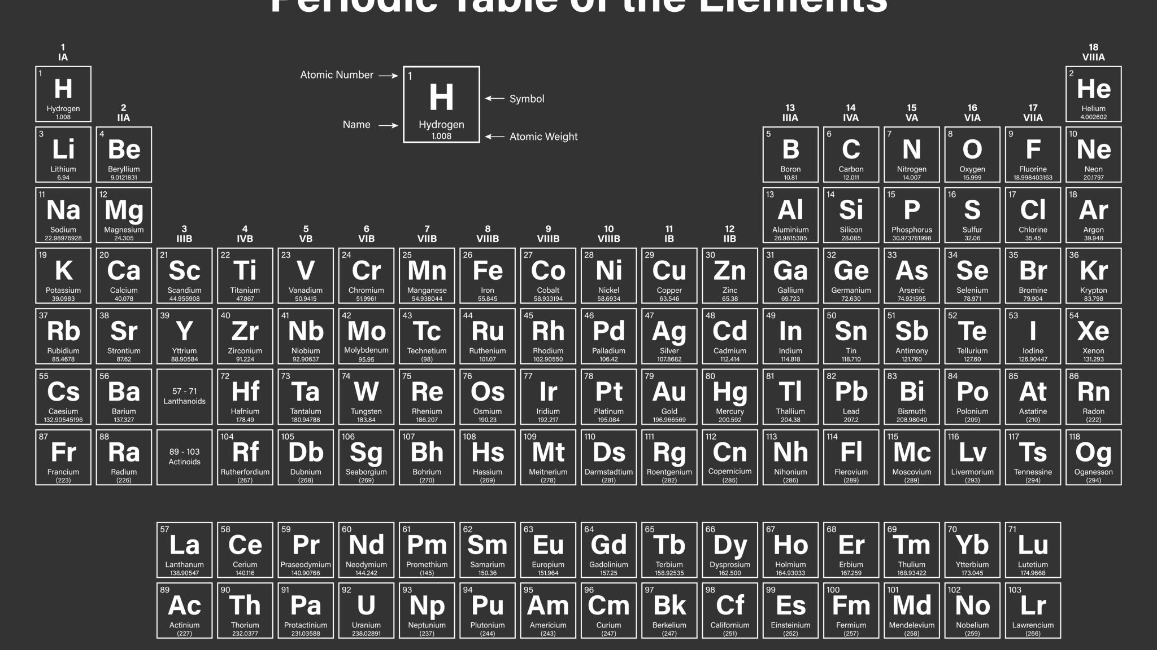
References
[1] D. Bauer and R. Lindstrom, “RECOVERY OF CERIUM AND LANTHANUM BY OZONATION OF LANTHANIDE SOLUTIONS.,” no. May, 1968.
[2] C. Gupta and N. Krishnamurthy, “Extractive metallurgy of rare earths,” Int. Mater. Rev., vol. 37, no. 5, 1992.
[3] N. Mccoy, “The Extraction of Europium from Monazite Residues and the Preparation of Pure Europium Compunds,” vol. 1145, no. 3, 1936.
[4] M. Albander, “Chemical Extraction, Benefication, Production and Application of the Rare Earth Metals,” 2012.

